Slide 1


Spread Sheet Project: AstroSage Analysis
Project by Tammana Sai Manikanta
Date: 18 May 2025

Slide 2


Agenda
PROBLEM STATEMENT
DATA DESCRIPTION
DATA CLEANING
ANALYSIS OF OBJECTIVE QUESTIONS WITH KEY METRICS AND VISUALIZATIONS
SUBJECTIVE QUESTION FOR INSIGHTS

Slide 3


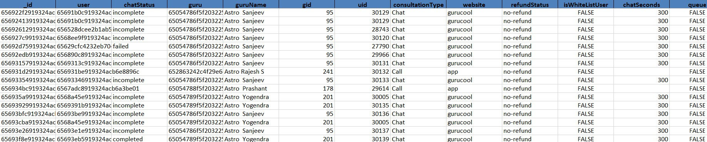
Problem Statement
AstroSage has received a 1 crore investment and aims to optimize its call center operations. The goal is to determine how to allocate this investment to maximize operational efficiency, customer satisfaction, and profitability. The analysis will consider historical call data, performance metrics, and market trends to make informed decisions.
Attaching the Excel, PPT, word files google drive link:
https://drive.google.com/drive/folders/1fHVO-ITirrWAuY2Yges96uswfZDJN9_Q

Slide 4


Introduction
AstroSage is one of the most authentic astrology destinations for not only those who are seeking astrological assistance, but also for high-level astrological research and development on wide scale.
AstroSage has democratized jyotish by introducing which will provide the high-level astrological research and development on wide scale
It is a prolific astrological source for people to help them out from queries to specialized users. Our aim is to provide the insights for those who are facing problems and betterment of humanity using divine science of astrology
The Agents will connect with users to provide the solution for the users based on their horoscope and zodiac signs by guiding them what should be done from users side for good cause.

Slide 5


Objectives
The Primary goal is to provide a comprehensive solution and data driven view from analysis to the AstroSage organization
Analyse the data that is provided and provide the insights and suggestions to the organization
Provide the suggestions based on the trends which will improve the User satisfaction which correlates with the Total Revenue
Provide the thoughts and suggestion on the investment which helps the growth of the organization

Slide 6

Data Cleaning
Step 1 : Acquire the data & Understand
Step 2 : Clean the data by modifying the data and fill the blank values by using aggregate excel functions and formatting the data based on the attributes
Step 3: Transform the data by using necessary excel formulas to aggregate the values for the fields that needs to be considered (Text, Sum if, Count if, average, Left, Date & Time, Pivot Table, Charts, filters, Slicers)
Step 4 : After transforming prepare the dashboard by using necessary charts, filters & slicers based on the aggregated values from the data that required
Step 5 : Provide the insights from the values from transformation and dashboard and callout the necessary fields which ever needs to be considered for the objective
Step 6 : Improvements/Suggestions will be provided on the data considering the insights which will eventually help the organization to grow gradually
Improvement/ Suggestions to present
Acquire
Understand
Data Cleaning
Transform
Dashboard
Insights from the trends

Slide 7















Key Performance Indicator – Values
KPI’s Key Performance Indicator
Total Users 28027 are existing
Total 131 Astro Guru’s (Agents) are working
Total Revenue Generated from Users
Total Earnings of Astro Guru’s from Revenue
Total Operational Cost
Overall Call Option used%
Total Users 28027
Total Astro guru
131
Total Revenue Generated
213987.31
Total Earning of Astro Guru
99147.57
Operational Cost 114840.74
Overall Call %
30.35%

Slide 8

Analysis of calls on each day
Day vs Users Consulted
147
2024-01-02 324
112
2023-12-31 307
325
2023-12-29 397
464
2023-12-27 533
454
2023-12-25 472
384
2023-12-23 356
329
2023-12-21 184
123
2023-12-19 150
99
2023-12-17 97
134
2023-12-15 161
140
2023-12-13 158
176
2023-12-11 206
205
2023-12-09 146
72
2023-12-07 150
151
2023-12-05 126
144
2023-12-03 131
138
2023-12-01 126
0 100 200 300 400 500 600
Total Calls recorded on daily basis to check the workload of Agents
Total Calls received = 8508 including failed
As we can see that on 10 December 2023 and 11 December 2023 recording most no. of calls irrespective of the status of the calls
On the day where we have seen the highest number of calls recorded around 45% of calls were completed rest all are failed, Busy, Incomplete etc.
On an average approx. 2 calls are being handled by Agent per day
Suggestions:
As the calls are not getting completed we can hire some new Astro
Guru’s (agents) to manage the workload of the existing agents.
Rotation of Agents by Shifts for working hours can be done to manage the workload during the night times where most of the other region users will be connecting in the evenings.

Slide 9
Rating Analysis based on Users Satisfaction for Sessions
High Rating - (5, 6, 7, 8) = 7704 =27.4%
Low Rating – (0, 1, 2, 3, 4) = 20323 = 72.51%
After analysing this above data based on ratings, we can see that around 27.4% were satisfied with the ratings which are par above than usual or average rating and the rest 72.51% were gave their rating 4 or below 4 which below par
Suggestions: Invest in Astro Guru’s as we received less rating via call options and we can train the chatbots by
creating new AI chatbots as well
Row Labels | Count of user_unique_id
0 | 7256
1 | 2199
2 | 4329
3 | 4407
4 | 2132
5 | 2169
6 | 1829
7 | 1824
8 | 1882
Ratings vs count of Users
1882
1824
1829
2169
2132
4407
4329
2199
8
7
6
5
4
3
2
1
0
7256
8000
0
2000
4000
6000

Slide 10
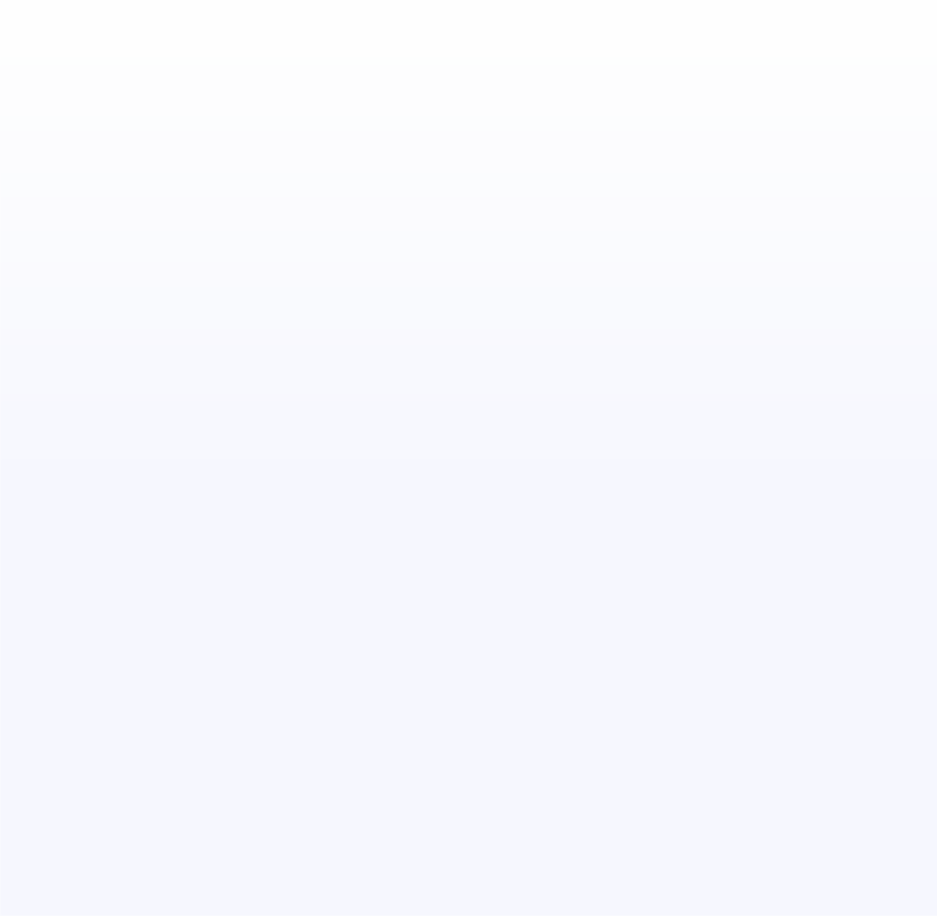
Call Distribution across the Each hour on all days
Calls Distribution Vs Hours
Call Distribution vs Hours
There is a huge traffic between 6 and 10 in morning and between 14 and 16 during lunch and noon time
Shift Allocation: To overcome this we can have more agents available and even we can start rotating the agents by allocating the shift timings to ensure that all users can be connected to the agents as the bookings happened.
During the night time IST hours we can see that there is no much workload so we can have less number of agents to be available at that time.
2000
1855
1875
1800
1747
1673
1591₁₅₇₄
1773
1664
1673
1704
1600
1438
1472
1443
1400
1200
1153
1099
1000
912
856
800
600
560
553
400
304
347
226
268 267
200
0
0 1 2 3 4 5 6 7 8 9 10 11 12 13 14 15 16 17 18 19 20 21 22 23

Slide 11
Analysis based on Ratings & Earnings
Top 10 Guru’s with Good Ratings
Astro Krishna received the good ratings as he is having the Highest Guru Satisfaction score as he received “8” rating 169 times which is highest.
Astro Yogendra Lowest ratings Guru Satisfaction score as he
received “0” Rating 482 times which is lowest.
Suggestions: Company can implement strategies like-
Training (Includes usage of tools as well)
Bonus Incentives/ Rewards
Performance Metrics / Workbook
Astro Krishaa
Astro Sakthi
Astro Shalini
Astro Brejesh
Astro Divya
Tarot Gurpreet
Astro Ruchi
Astro Sonam S
Tarot Bee Riya
Astro Yogendra

Slide 12
Status of the CallVrType
Consulting Type
Call Option Used vs Status
failed
We can see only 57% calls were completed and rest 43% are in-completed status
As we are using only Exotel as CallVrType we can have other alternate services the expanding the other alternative services
Suggestions:
We can start training the staff to use the latest systems and technology
RCA needs to be documented for Incompleted status calls as we need to improve on those aspects by booking the busy slots accordingly in the free slots to provide the sessions
busy 8%
2%
no-answer 33%
completed
57%

Slide 13











Consultation distributions across all the options available for the Users:
Source of Contact
dashb oard
app _{0%}
28%
guruco ol 72%
Website distribution:
gurucool = 20225 = 72%
app = 7800 = 28%
dashboard = 2 = 0.000071%
Suggestions:
As gurucool, is only website service which is there for users to connect as it is containing huge load creating traffic we can create alternative services and can be used both in parallel to avoid traffic. It is having the rating as 2.71 where it clearly shows the dissatisfaction from the users. So definitely we should focus on improving the AI chatbots to provide the auto replies to the users which can satisfy the users.

Slide 14






Sum of net amount generated from Users
Sum of netAmount vs Days
40000.0
We can see that there is a stake in Thursday which is a mid week day where the services are less and apart from Thursday all other days are having the services which were scheduled and being delivered
35000.0
34799.0
30698.1
31202.4
31638.5
31151.0
30000.0
29251.7
25246.5
Most of the revenue is generated from Wednesday, Friday and Saturday where we can have more Agents in place to provide the service for the users
25000.0
20000.0
15000.0
10000.0
5000.0
0.0

Slide 15
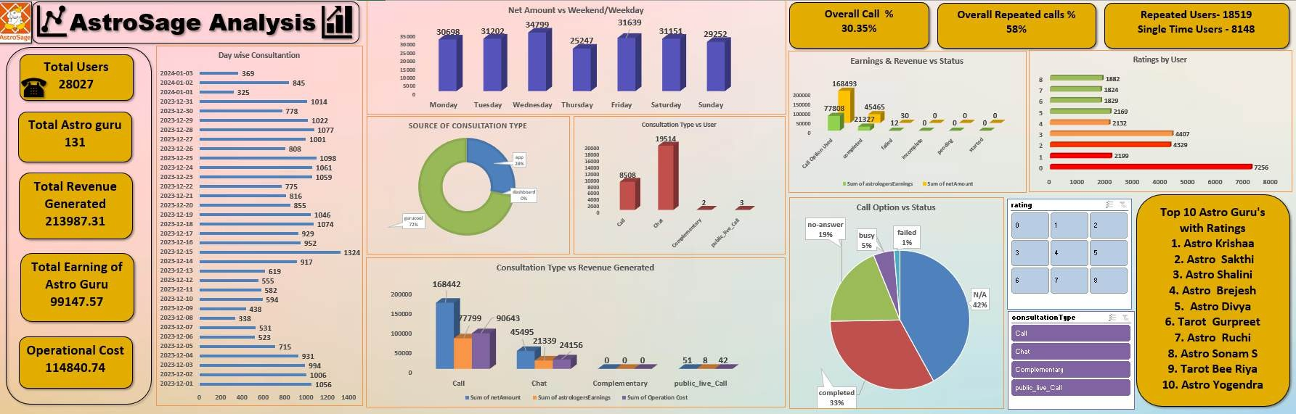
Dashboard
For Reference: https://drive.google.com/drive/folders/1fHVO-ITirrWAuY2Yges96uswfZDJN9_Q

Slide 16


Correlation
Correlation between call duration and customer satisfaction is very less = 0.2
Which means it is having no meaningful relationship between the call duration and customer satisfaction. It
should be at least 0.9 to having a correlation where is shows the dependency between the two factors.
Correlation between the agent earning and net amount because if the net amount is directly proportional to the agent earning = 0.995
As users sessions are completing the revenue will be generated which will increase the Astro Guru’s
earnings.
A correlation of 0.995 suggests that very strong positive linear relationship between the two variables. This means that as one variable increases, then the other variable will increase automatically in a similar predictable pattern.

Slide 17
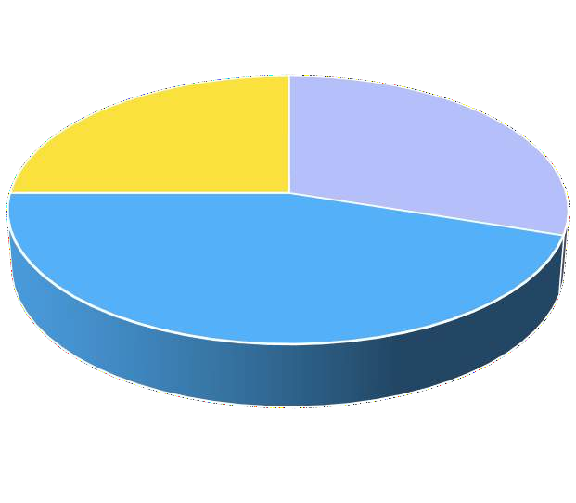
Improvements / Suggestions
1 Cr needs to be invested in these 3 sectors:
1. Training & Hiring New agents- 30 %
Adding the Revenue to organization
Recruiting New Agents who are having a vast experience in this field. We can
offer some bonus, incentives, shift allowances for shift to engage the agents or _{Marketing}
staff who are working.
2. Technology & Upgrading- 45%
Training & new Agents 30%
25%
As Call centre Technology need to be upgraded as currently, they are having Exotel as call service option where we can see the attributes like some calls are not getting connected.
As this is concerned, we can have more call service options or we can upgrade the Exotel service or can look for other alternate services or we can include other alternative services
Technology
&
Upgrading 45%
Training & new Agents
Technology & Upgrading
Marketing-25%
We can start promoting our organization by giving some offers like discounts, and conducting live session for free on weekends, advertising in malls, premium membership with complimentary sessions, discounts for upcoming sessions post completing one or two sessions
Marketing

Slide 18
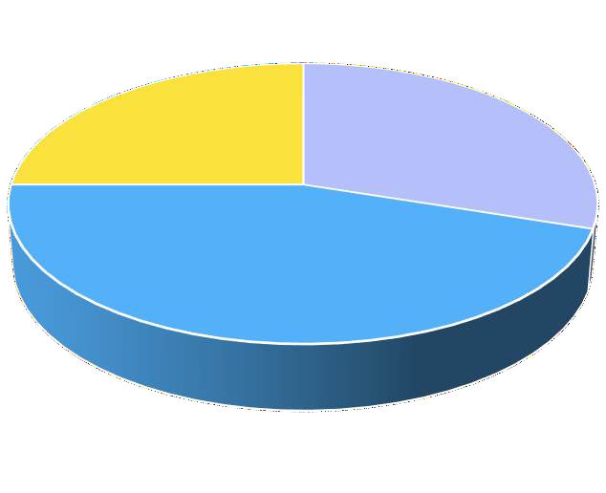
Improvements / Suggestions
Training & Hiring New agents which will eventually help the existing agents by improving their knowledge to deliver more good services to existing users in sessions and will help in getting new users to organization which will have the impact on the Revenue generation.
Though ROI will impact but we can retain the existing agents by adding some incentives, bonus and bond period
Technology & Upgrading- We can upgrade the technology and adding the alternative services like call type which will help the users to connect with agents by avoiding the failure or busy scenarios
Marketing- We can start promoting our organization by giving some offers like discounts, and conducting live session for free on weekends, advertising in malls, premium membership with complimentary sessions, discounts for upcoming sessions post completing one or two sessions.
Adding the Revenue to organization
Marketing 25%
Training & new Agents 30%
Technology & Upgrading 45%
Training & new Agents Marketing
Technology & Upgrading

Slide 19
THANK YOU !!

